Slide 1
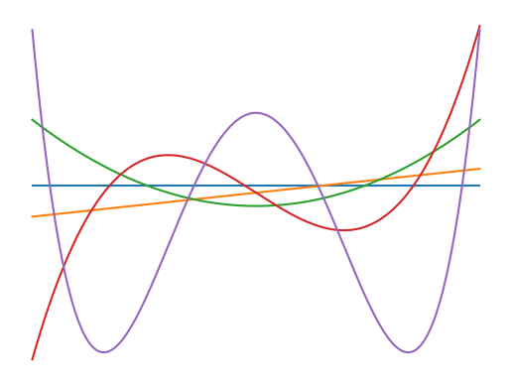

Polynomial Chaos Expansion (PCE)
Uncertainty in Machine Learning Seminar
(WiSe 23/24)
Notes:
Chaos -> System

Slide 2



measuring uncertainties of mechanistic simulations
applied to problems where the simulator function is known
Notes:
one of the key tools in applied mathematics and engineering
mechanistic simulations
key characteristic:
the right model or simulator is known (physical processes)
only measuring uncertainties of parameters

Slide 3
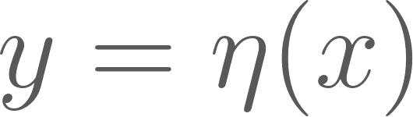
Monte-Carlo Sampling
Surrogate
Notes:
well established in engineering community
Problem: have a function with input x and output y
want to characterize the output distribution with respect to the input distribution
X is a random variable with uncertainties
> dist and uncertainties might be unknown
most applications are about calculating fluid dynamic systems (more general Differential Equations)
well established approach in the field of Uncertainty Quantification
Microelectronic devices, fluid dynamics, so in physics, chemistry or biology -> described by complex nonlinear models
Solution:
Monte-Carlo Sampling:
sampling from X might be hard or impossible as the the dist. might be high dim and/or unknown
Eta might be very expensive to evaluate (days or weeks)
Surrogate:
sampling from X still a problem
surrogate is itself just an approximation of eta (additional uncertainty)
Polynomial Chaos:
is a method to represent a random variable/ multiple variables / or random fields in terms of a remedy variable with a simpler dist.

Slide 4

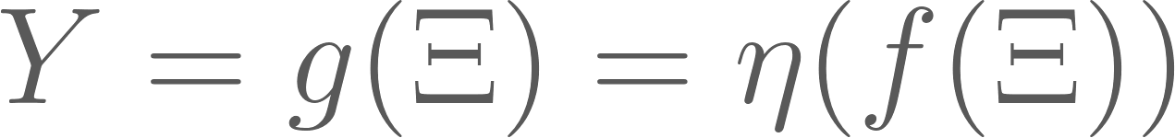
Construction
Representing an arbitrary random variable of interest as a function of another random variable with a distribution of choice.
Representing the function as a Polynomial Expansion
Note:
It’s always possible and there are always many solutions.
Notes:
Start by defining a random variable by a different random variable and a function f
This is always possible and there are always many such solutions

Slide 5
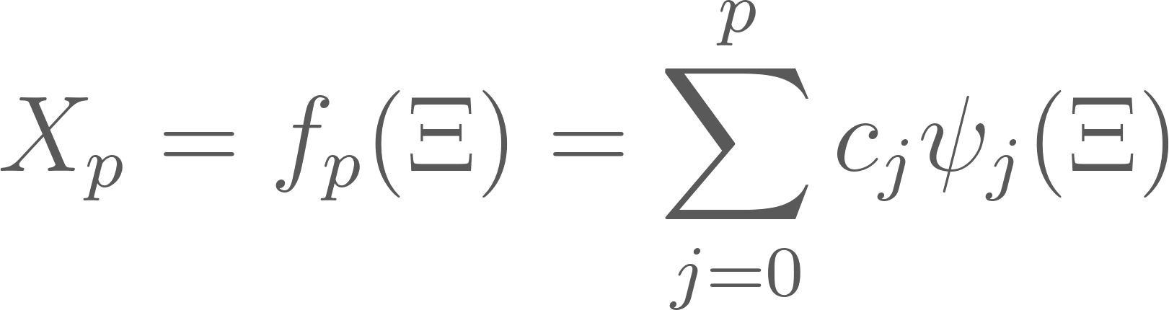
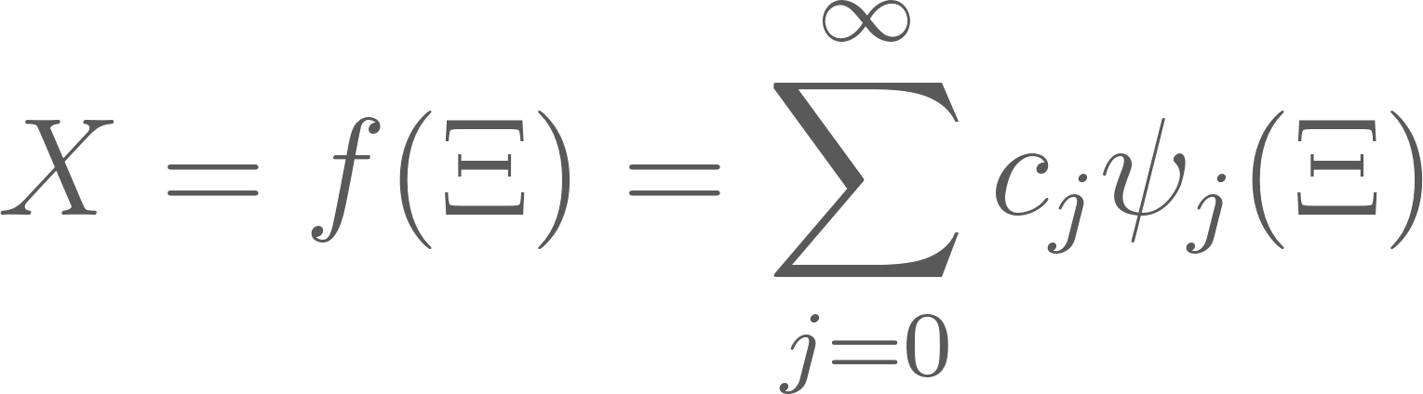
Construction
germ (germ distribution)
orthogonal polynomials
mode strength
truncation
Notes:
“A PCE is a way of representing an arbitrary random variable of interest as a function of another random variable with a given distribution and of representing that function as a polynomial expansion.”
Defining the input X as a polynomials expansion
germ distribution:
simpler variable is psi and is called the germ distribution
usually a simple and easy to sample distribution
mode strength:
summation factor that has some very handy properties -> we see that later
Notation can be confusing for MLers (not the jths input)
for output they are called y’s
orthogonal polynomials of j order:
a set of specific polynomials that are orthogonal to each other -> define that later
truncation:
need to make the sum finite
there are always many such expansions
less or more optimal

Slide 6
Germ
can be chosen arbitrarily (usually with a simple to sample dist.)
e.g. Gaussian or Uniform
new input to function

Slide 7
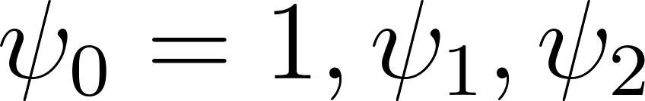
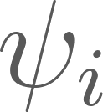

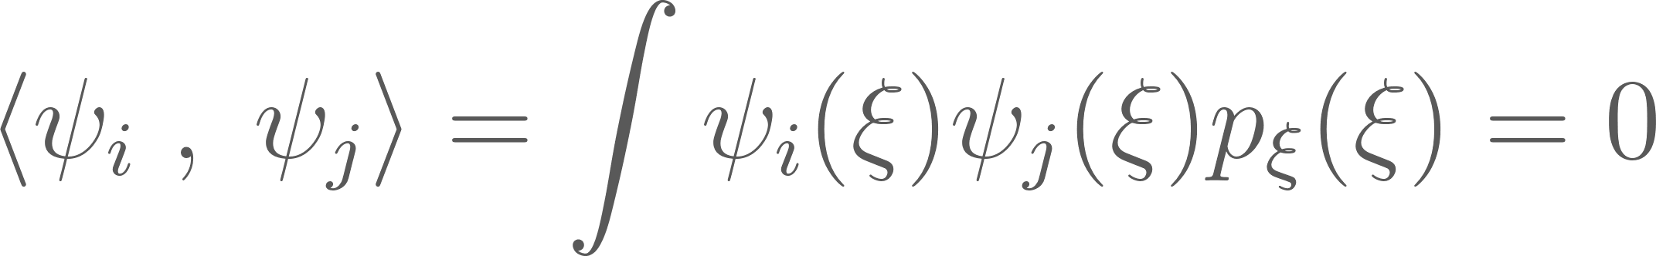
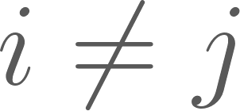
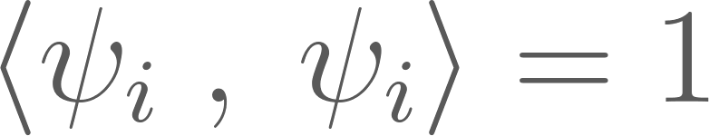
Orthogonal Polynomials
Polynomials are orthogonal wrt. the germ dist.
Germ dictates the polynomial basis functions
… where is a polynomial of order
for
Notes:
orthogonal with respect to the germ distribution
could use any polys for germ but there are certain families for certain germs that guarantee exponential convergence
wiener-askey scheme

Slide 8
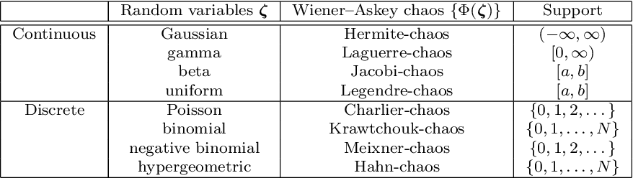

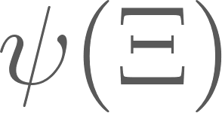
Askey-Scheme
(generalized PCE)
defines polynomial families for different germ distribution
[3] Xiu et.al
Notes:
the choice of the germ dist. dictates the polynomial basis functions -> set to be the optimal choice for an exponential error decay
make assumption on the prior distribution of the inputs (uncertainties) -> new approx. error

Slide 9

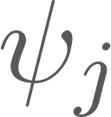
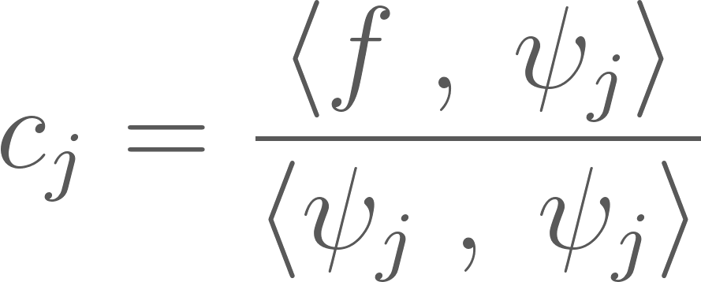
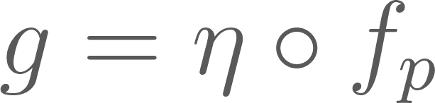
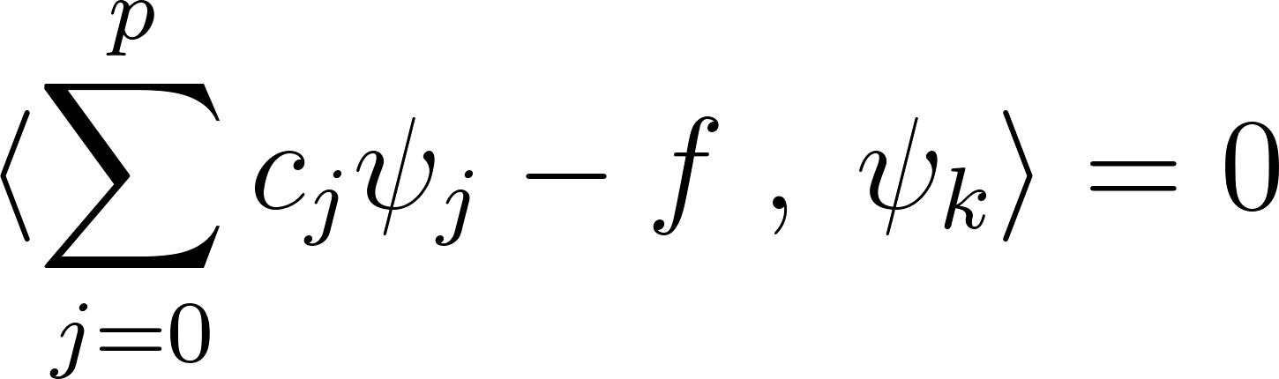
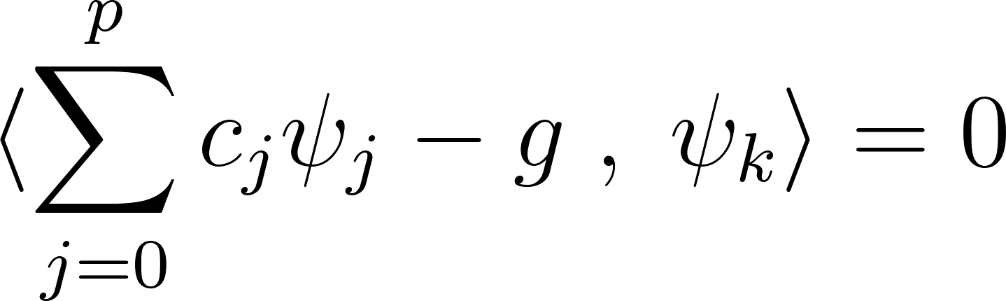
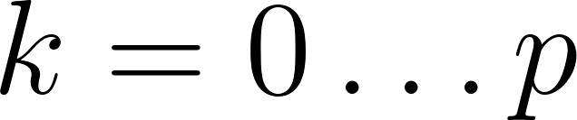
Mode strengths
Intrusive
(Galerkin Projection)
For a given and ‘s, there is a unique solution given by
Same for
for given and
appr. error is orthogonal to each basis term
solved analytically
for all
Notes:
denumerator already defined by construction of polynomials
there are always many such functions f -> only differ in mode strength
numerator requires to evaluate an integral: for a simple f, this might be still possible
same holds for the output function g: usually not simple, thus integral infeasible to compute analytically
-> numerical integration (new uncertainty)
is tailored to the particular simulator. Need to recalculate if germ changes or simulator changes

Slide 10
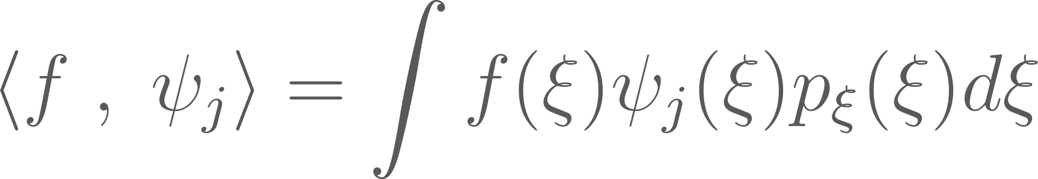
Mode strengths
Intrusive
(Galerkin Projection)
For a given and ‘s, there is a unique solution given by
Same for
for given and
Non-intrusive Methods
Problem: Analytic solution might not derivable!
Notes:
denumerator already defined by construction of polynomials
there are always many such functions f -> only differ in mode strength
numerator requires to evaluate an integral: for a simple f, this might be still possible
same holds for the output function g: usually not simple, thus integral infeasible to compute analytically
-> numerical integration (new uncertainty)

Slide 11
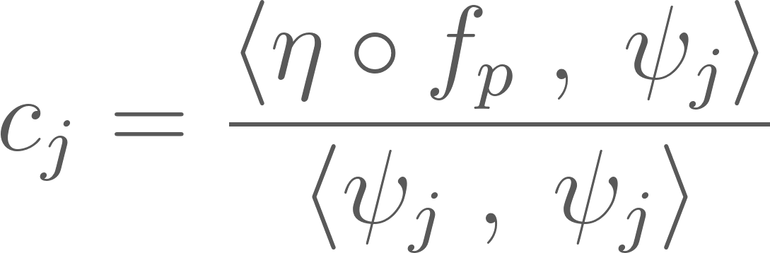
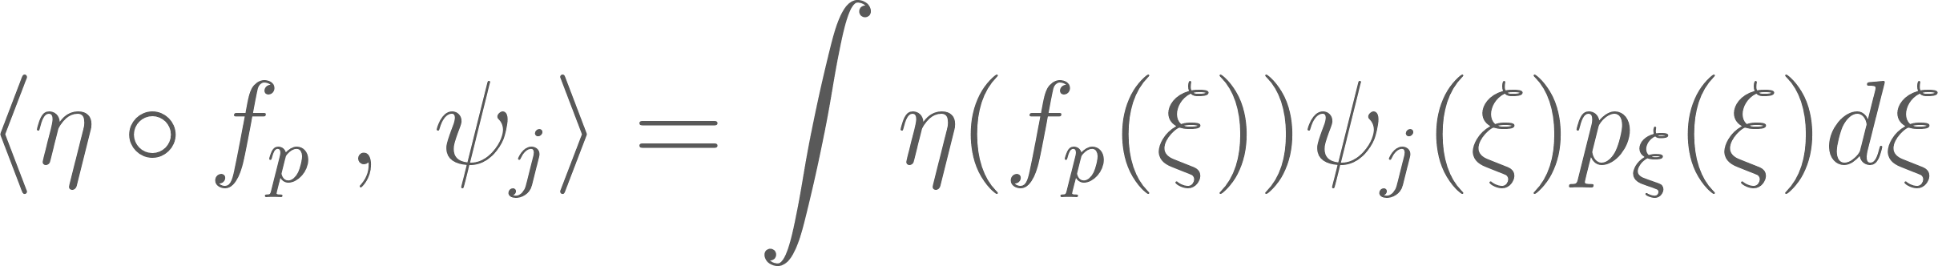
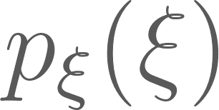
Mode strengths
Non-Intrusive 1
Treat simulator as a black box
solved numerically
Solve by sampling from and using Monte-Carlo
Gaussian Quadrature Rule
Notes:
call xj now yj as this most often applies to output models (but they mean the same)
I start with the non-intrusive methods as they try to solve the integral we’ve seen before directly
consider the computational model as a blackbox
use MonteCarlo to evaluate the integral or Gaussian Quadrature Rule
introduces more uncertainty
Downsides:
which points to choose
error does not necessarily decrease with more samples

Slide 12
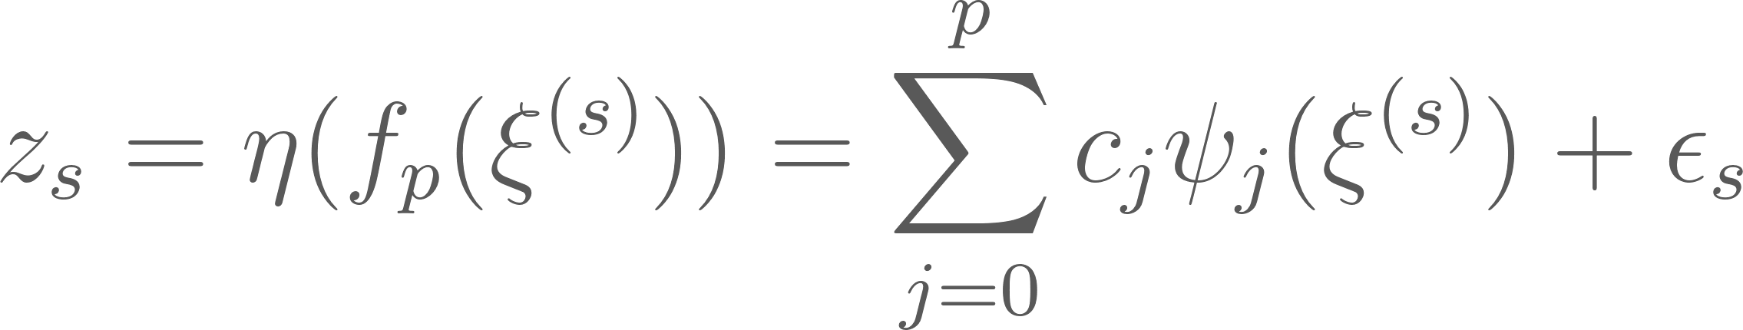
Mode strengths
Non-Intrusive 2
Treat simulator as a black box
Use simulator samples as observations
Regression Problem (optimize by Least Squares)
Notes:
Also sample from germ distribution

Slide 13
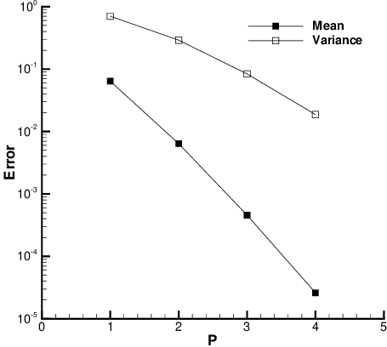
Truncation
exponential decay
only when optimal polynomial system for specific germ
[3] Xiu et.al
Notes:
“Truncation is where it matters what PC representation we use for a given X. A good representation f in practice is one for which the truncated representation fp with small p will be a good approximation.”

Slide 14


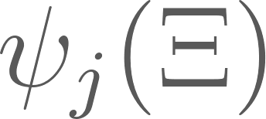

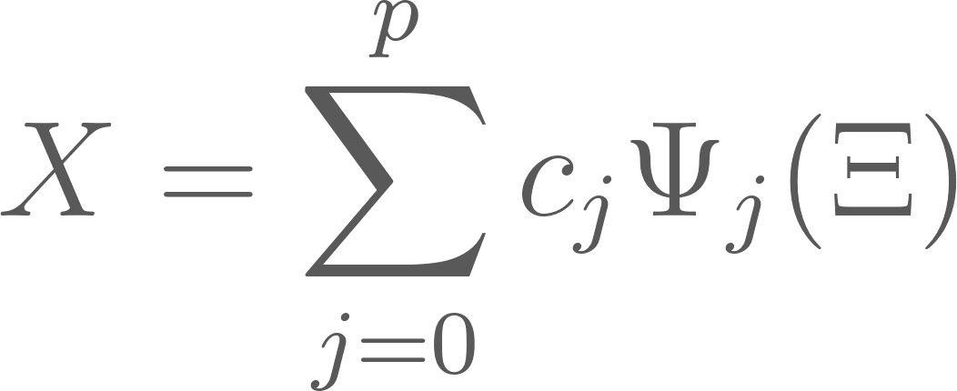
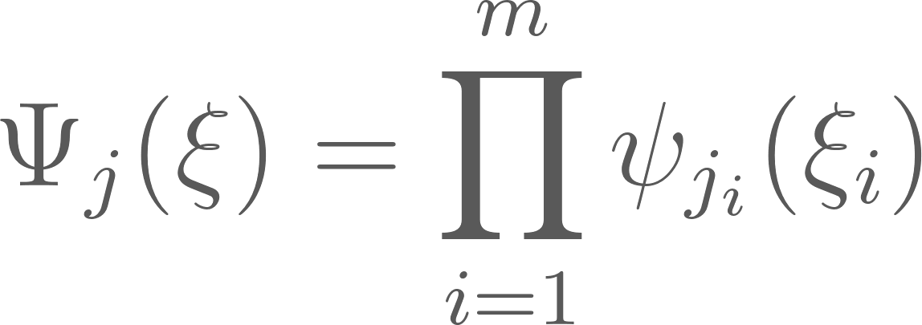
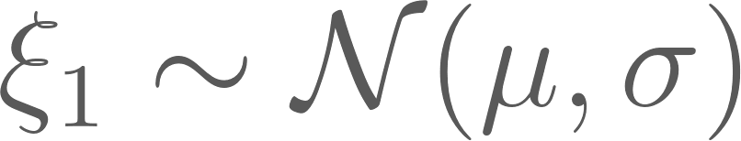
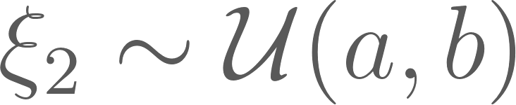
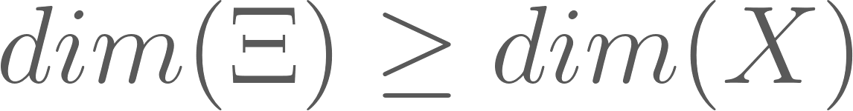
Multivariate Case
If is a vector then is a vector
If is a vector, then the polynomial is multivariate and we write
Example:
Note:
usually
leads to better representations
Notes:
only possible if germs are independent -> if not, a Rosenblatt transform is usually applied to make them independent
can extend to random fields
a tensorproduct
m = # uncertainties

Slide 15
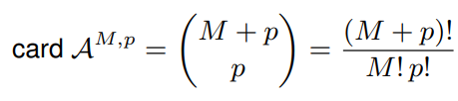
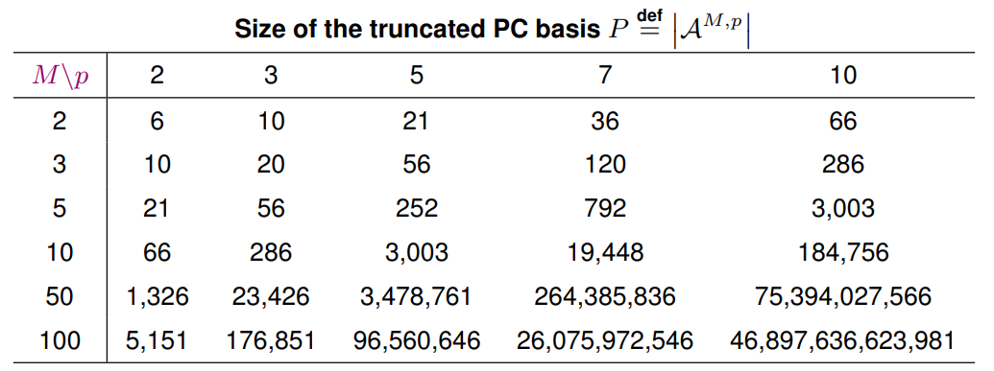
Multivariate Case
[6] Sudret, Bruno
Notes:
In the multivariate case the number of equations grows rapidly

Slide 16

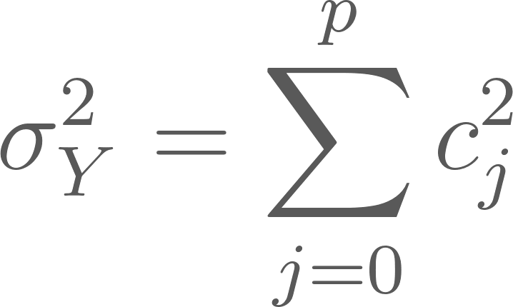
What do we get from a PCE?
mean:
variance:
higher statistical moments (skewness etc.)
Notes:
We’ve seen what a PCE expansion is and how to construct one. But how does it help now?
Variance = E[Y^2] - E[Y]^2 if orthonormal

Slide 17
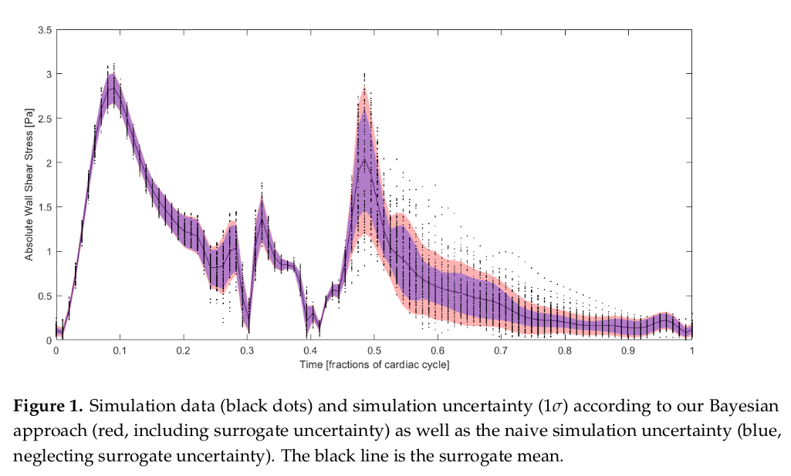

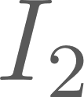
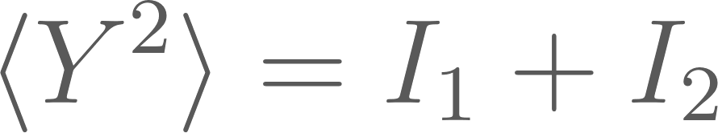

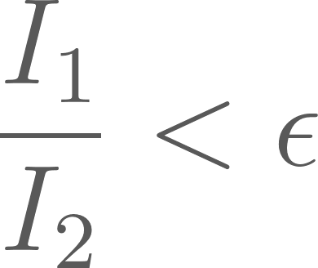
Discussion
Adds additional Uncertainties
Variance is composed of the uncertainty of the observables and the uncertainty of the surrogate itself
Trustworthy if ratio is sufficiently small
[2]: Ranftl, Sascha and Wolfgang von der Linden
Notes:
They have used Bayesian Probability Theory for surrogate models and came up with a natural measurement of surrogate trustworthiness
The surrogate uncertainty was usually neglected
“suggesting a measure of trustworthiness of the surrogate by quantifying the ratio of the surrogate uncertainty to the total uncertainty.”

Slide 18
Discussion
Adds additional Uncertainties
Change of simulator function or dist. of input requires recomputing every step
Exponential growth of parameters
Need to know the input distribution explicitly
Notes:
we’ve seen that the number of equation grows dramatically with higher p and m

Slide 19
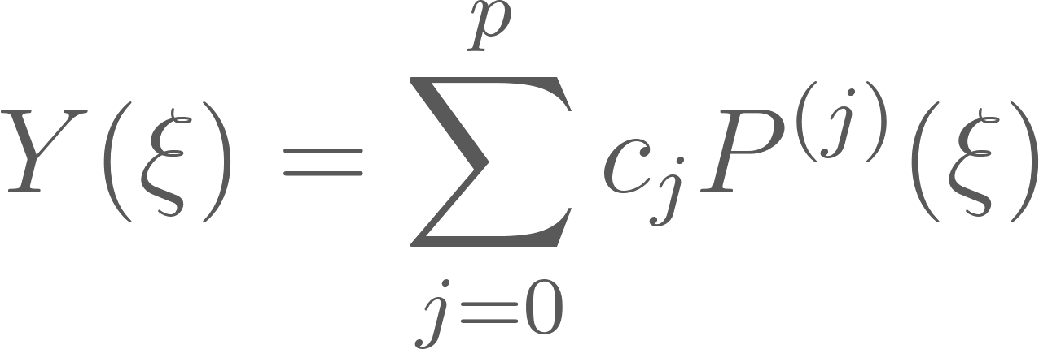
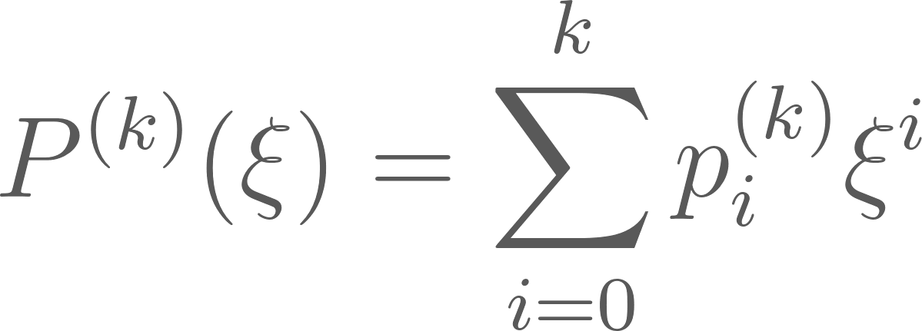
Arbitrary Polynomial Chaos (arbitrary PCE)
construct Polynomial Basis for arbitrary germ distribution
Germ distribution doesn’t have to be known explicitly
moments are sufficient
Notes:
exploit the orthogonality constraint
iteratively substitute the lower polynomials into higher order ploys -> definition of degree k uses definition of all lower degree polys
rewrite to only use the moments -> arrive at a big matrix product
easier for dists with dependent uncertainties

Slide 20
Is PCE for Uncertainty in ML practical?
Not an established method in the field of ML
PCEs curse of dimensionality is a big limitation for most of ML applications
VAE
PCENet [5]
Encoder
L
Decoder
PCE
Output dist.
Notes:
not yet established
some facts make it not directly adaptive for many ML problems:
rapid parameter growth is especially in ml a problem
-> not practical for most ml applications
-> rely on non-intrusive method also because we don’t know the function
-> PCENet a cool project that tries to solve this problem with reasonably good results
gains momentum:
used for regression tasks

Slide 21
Take Away
Construction
Specific Orthogonal Polynomials Basis for given germ
Properties
A surrogate method
Easy to sample from (generate inputs for simulation)
Measure Input/Output Uncertainties and Sensitivity Analysis
Mean and Variance available in closed form
Input distribution can be unknown and of any type (aPCE)
Limitations
Exponential growth of number of parameter
Introduces additional Uncertainty
Notes:
At the end, I want to summarize the key ”take aways”
Construction:
Now, you should know how a PCE is set up. That the choice of polynomial is not arbitrary but dependant on the germ distr.
Properties:
…
Limitations:
…

Slide 22



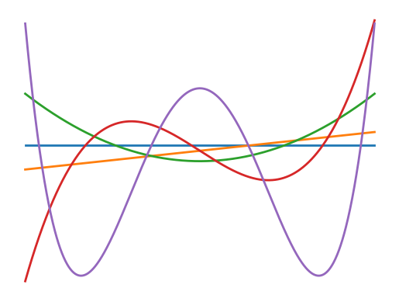










Notes:
Chaos -> System or Process

Slide 23
Literature
O’Hagan, Anthony et al. (2013). “Polynomial chaos: A tutorial and critique from a statistician’s perspective”. In: SIAM/ASA J. Uncertainty Quantification 20, pp. 1–20.
Ranftl, Sascha and Wolfgang von der Linden (2021). “Bayesian Surrogate Analysis and Uncertainty Propagation”. In: Physical Sciences Forum 3.1. issn: 2673-9984. doi: 10.3390/psf2021003006. url: https://www.mdpi.com/2673-9984/3/1/6.
Xiu, Dongbin and George Em Karniadakis (2002). “The Wiener–Askey polynomial chaos for stochastic differential equations”. In: SIAM journal on scientific computing 24.2, pp. 619–644.
Oladyshkin, Sergey and Wolfgang Nowak (2012). “Data-driven uncertainty quantification using the arbitrary polynomial chaos expansion”. In: Reliability Engineering & System Safety 106, pp. 179–190.
Shustin, Paz Fink, Shashanka Ubaru, Vasileios Kalantzis, Lior Horesh, and Haim Avron. “PCENet: High Dimensional Surrogate Modeling for Learning Uncertainty.” arXiv, February 11, 2022. http://arxiv.org/abs/2202.05063.
Sudret, Bruno. “Polynomial Chaos Expansions in 90 Minutes.” Application/pdf, October 7, 2021, 101 p. https://doi.org/10.3929/ETHZ-B-000508852.
Notes:
glad to receive and answer your questions

